Slide 1
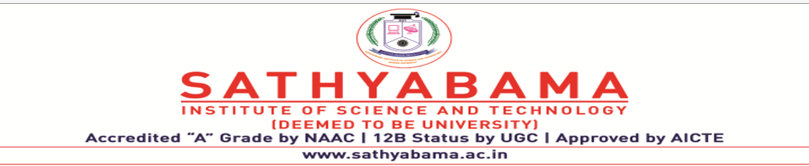
MS EXCEL AUTOMATION USING ROBOTIC PROCESS AUTOMATION (RPA)
PROJECT SUPERVISOR:- DR.MERCY PAUL SELVAN
Submitted by – B AMARNATH
Register no. - 39110181

Slide 2
COURSE CERTIFICATE
.

Slide 3
INTRODUCTION
• In this project, we will build a process to Grade Calculation Excel Automation that works over Microsoft Excel 2013 using Blue prism
• Robotic Process Automation (RPA) is a type of automation technology currently transforming the way businesses operate.
Excel automation streamlines your use of the application by automatically performing tasks.
• Generally in order to calculate grades we use manual formulas in excel. We also need to enter the marks manually each time. Our goal through this project is to automate this whole process with the help of RPA technology and blueprism We can avoid doing the rote and recurring task of calculating grade for each student based on their marks repeatedly and save time with the help of this project.

Slide 4
.
In almost every organization, the responsibility of performing various strategic tasks such as management of the recruitment process, termination process, payroll management etc. lies within the Human resource department.
Some of it may include Employee_ monitoring at different levels, payroll management, Employee_ benefits, training, and development, etc. In-order to make this work a lot easier, organizations across the world are investing in HR automation in-order to find out and perform the best human capital decision.
However, every organization are now looking for more advanced methods of automation, which may help them to manage various complex processes such as, Data storage, Data control and modifications, Effective communication process enhancement, better connectivity with all departments easily and swiftly which would also be useful for the long-term goals of the organization.
Information Technology has now considered as a potential tool that managers use, both generally, and in human resource functions, to increase the capabilities of the organization.

Slide 5
OBJECTIVES
● Gain insights into building blocks of Blue Prism automation.
● Importing MS Excel VBO (Visual Basic for Applications) in Blue Prism.
● Tuning Process Studio with specific needs.
● Working with different stages in the Process studio.
● Build a Grade calculation using MS Excel Automation that works over Microsoft excel.

Slide 6
PURPOSE
Manage Employee Information Efficiently.
Define the emoluments, deductions, leave etc.
In order to overcome the problem mentioned above,we will use RPA technology to automate the process of grade calculation.With the help of Digital Workers in Blueprism software our whole process of calculating
• Manage your own Security.

Slide 7
REQUIREMENTS
Pre-requirements for Blue Prism
• Creates and supports a digital workforce of industrial strength and enterprise
scale.
• Does not require IT skills to implement
• Can be implemented in sprints of 4 to 8 weeks (Start to finish)
• Is very low cost compared to the TCO of alternative solutions
• Provides tremendous payback with self-funding returns and an ROI that has been as high as 80%
• Can be managed within IT infrastructure and processes

Slide 8
Installation of Blue Prism
The following are the installation requirements for Blue Prism –
• Windows 10 (Preferred) OS, 64 bit
• Blue prism installation Software, 64 bit
• Blue Prism License File
• SQL Server Express Edition, 64

Slide 9
Software Requirements
• Operating system: Windows XP/Vista or any main stream OS
• Installation and Setup Guide for Blue Prism
• Installation and Setup Guide for MS Excel
• Blue prism Version: 6.10.1
• Blue prism License File
• Blue prism installation Software 64 bit
• MS Excel
• Windows 7/8/10

Slide 10
Hardware Requirements
• Internet connection to download and activate
• Administration access to install and run Blue Prism
• Minimum 10GB free disk space
• Windows 8.1 or 10.
Minimum System Requirements to run Office Excel 2013, your computer needs to meet the following minimum hardware requirements:
* 500 megahertz (MHz)
* 256 megabytes (MB) RAM
* 1.5 gigabytes (GB) available space
* 1024x768 or higher resolution monitor

Slide 11
Project Flow
● Importing Blue Prism MS Excel VBO (Visual Basic for Applications)
● Binding Process Studio with MS Excel VBO.
● Opening MS Excel Workbook.
● Specifying Blue Prism Stages to work on MS Excel Workbook in Blue Prism.
● Tuning Process Flow with Blue Prism Actions.
● Closing MS Excel Workbook.

Slide 12

FLOW AND IMPLEMENTATION
Idea:
Need to find a new one --“Generally, in the industries monitoring the machine status continuously and maintaining the records of the entire data plays a very important role as that helps the officials to analyze the production factors. This also helps in resolving some of the problems like machine failures, production delays, etc.

Slide 13
ACTIVITIES
Milestone 1: Configure the Process Studio
Let us create the Process Object bind with MS Excel VBO.
Object studio is mainly used to develop the objects. Inside the object, we have different types of actions as follows:
1. Application Modular to Spy the Elements
2. Initialize page and clean up page.

Slide 14
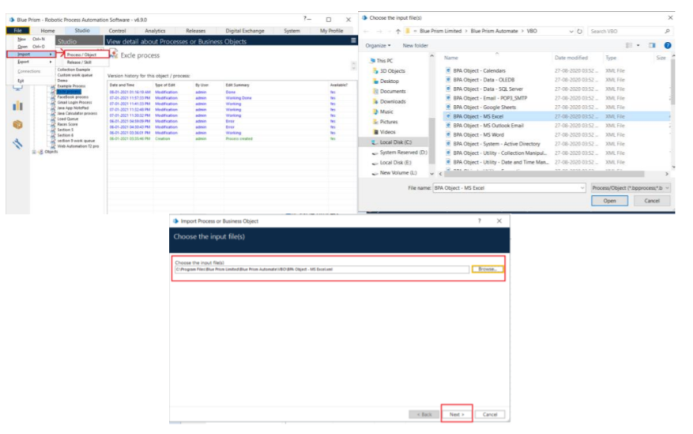
Activity 1: MS Excel VBO (Import VBO file)
File -> Import -> Browse -> (C:\Program Files\Blue Prism Limited\Blue Prism Automate\VBO\BPA Object-MS Excel). Click Finish.

Slide 15
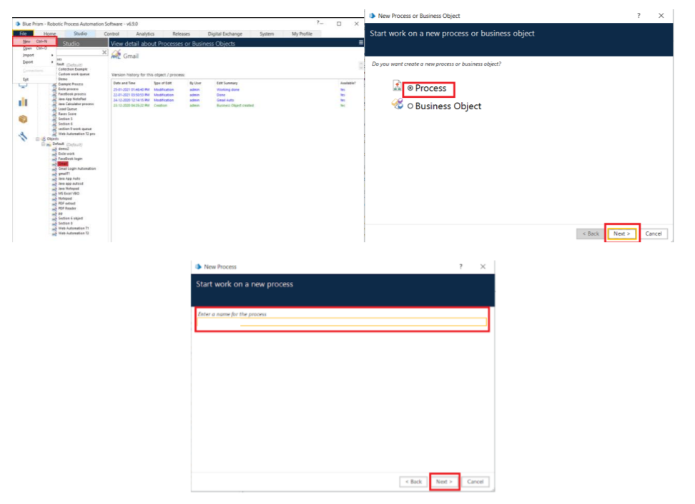
Activity 2: Creating the Process Object from Object Studio
Process studio has only the Main page. We can call from the process studio. We use the Process studio for developing and testing.

Slide 16
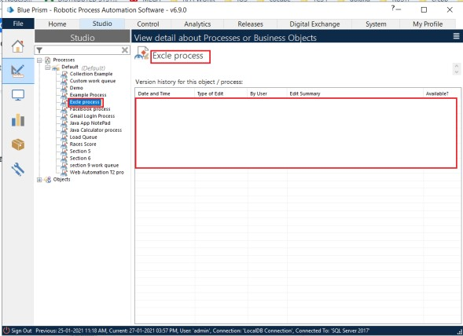
Open Created Process Model (Gmail Log In Process)

Slide 17
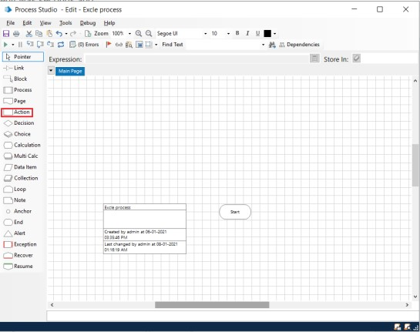
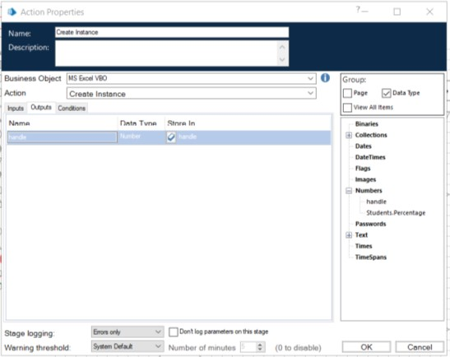
1. Create Action Stage as “Create Instance” (Business Object = MS Excel VBO; Action = Create Instance).
a. Click on the Outputs tab
I. Create Data Item, type = number, name = “handle”. Drag it into the store in column.
II. Click on ok.

Slide 18
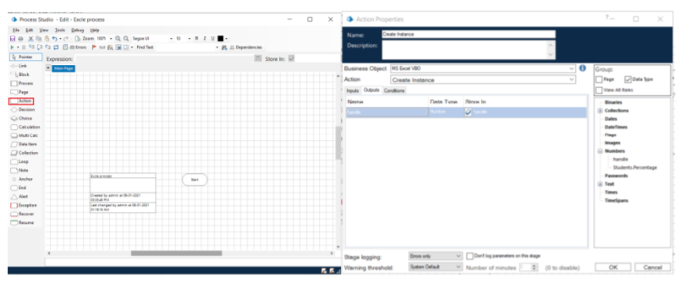
2. Create Action Stage as “Open Excel file” (Business Object = MS Excel VBO; Action = Open Workbook).
a. Click on the Inputs tab
i. Drag “handle” data item into handle Value column.
ii. Set file path of excel file in File Name Value column

Slide 19
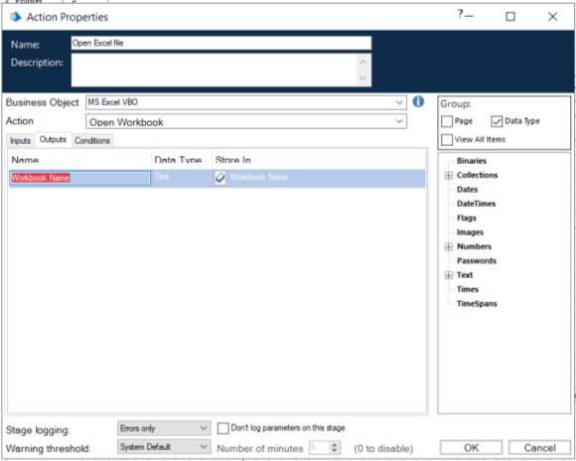
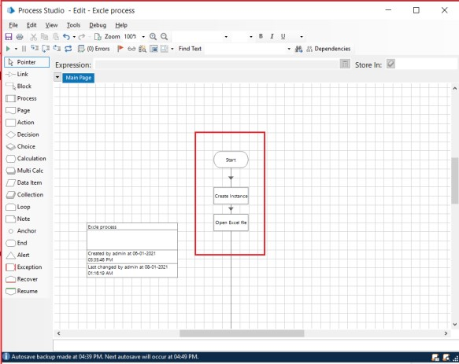
2(2) Click on the Outputs tab
Create Data Item, type = Text, name = “Work Book Name”. Drag it into the Store In column. Click on OK.

Slide 20
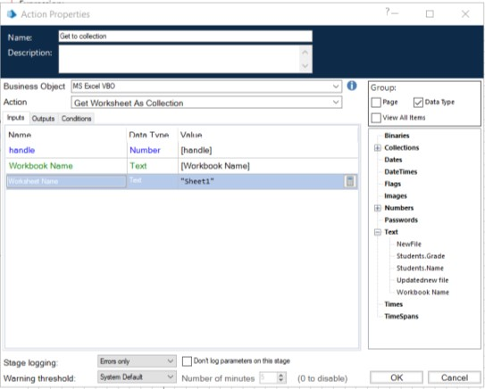
3.Create Action as “Get to collection” (Business Object = MS Excel VBO; Action = Get WorkBook As Collection).
a. Click on the Inputs tab
Drag “handle” data item into handle Value column.
Drage “Workbook Name” data item into the Workbook Name Value column.
Write Worksheet Name name as “Sheet1”.

Slide 21
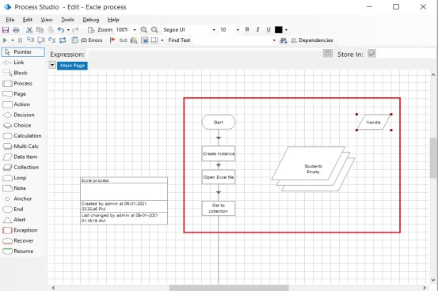
3(b). Click on the Outputs tab
Create Collection as “Students”, with the following fields.
Use Add Button to add fields in collection.

Slide 22
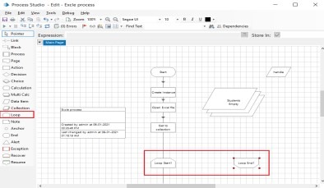
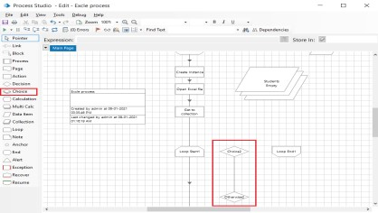
4. Drage Loop module, drage Choice module. Connect loop start with choice start. Open Choice Properties and create the following fields.
[students.percentage]>=70 AND [students.percentage]<=79
[students.percentage]>=80 AND [students.percentage]<=89
[students.percentage]>=90 AND [students.percentage]<=100

Slide 23
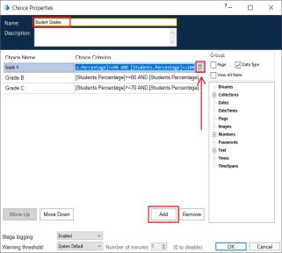
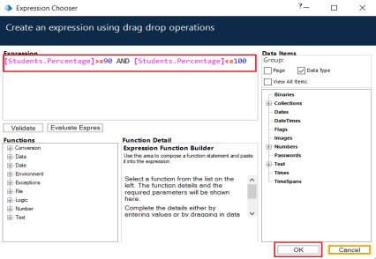
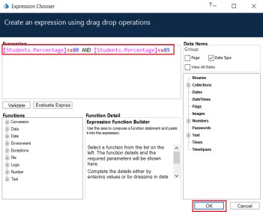
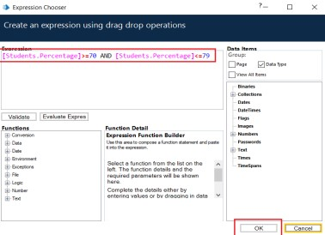

Slide 24
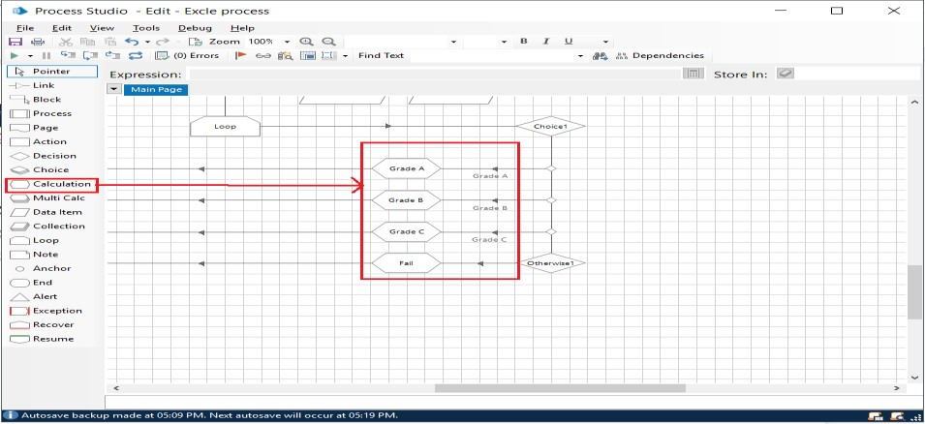
5. Create 4 Calculation modules.
1st Calculation module name as “Grade A”. Write an expression as “Grade A”.
Stores result in Students. Grade (Collection data item)
Repeat for rest “Grade B”, “Grade C” and “Fail”.
a. Do proper connection as below.

Slide 25
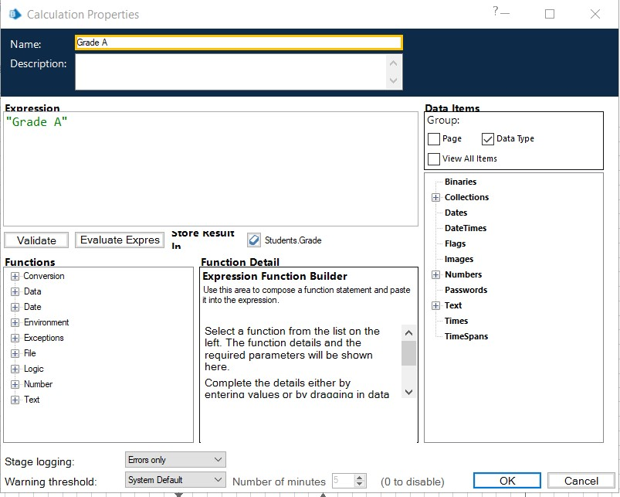
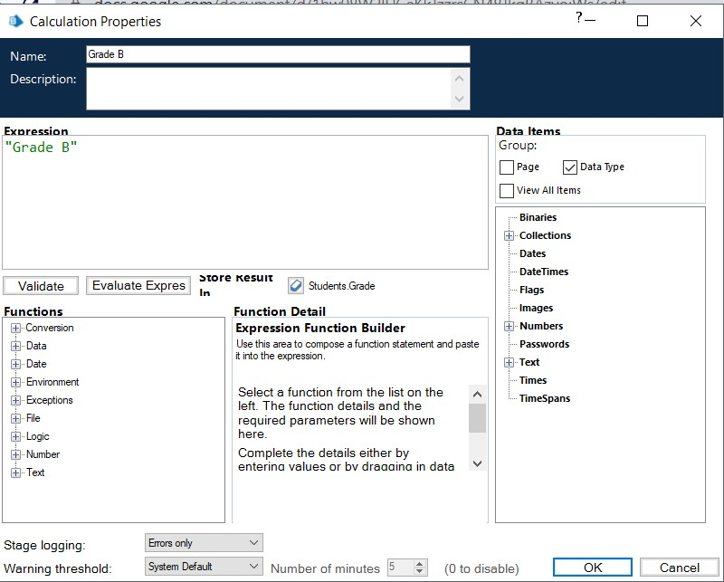

Slide 26
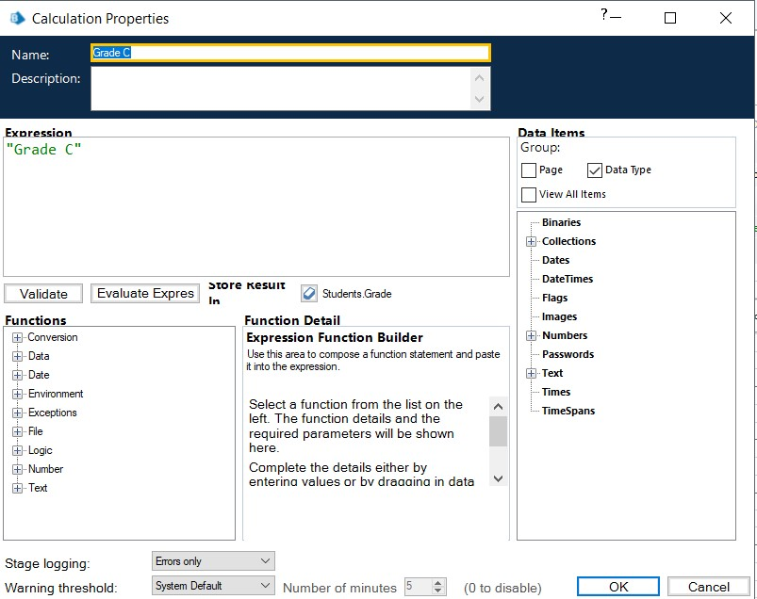


Slide 27
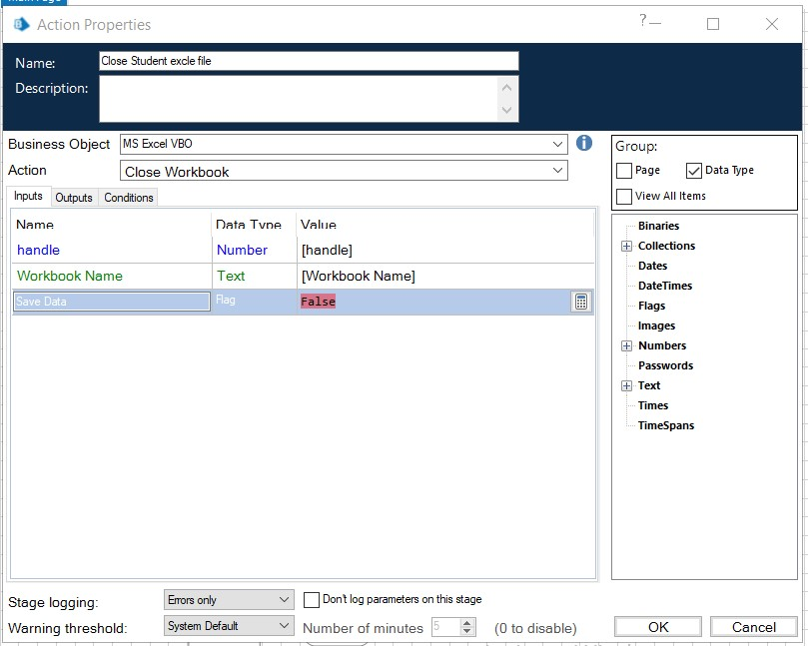
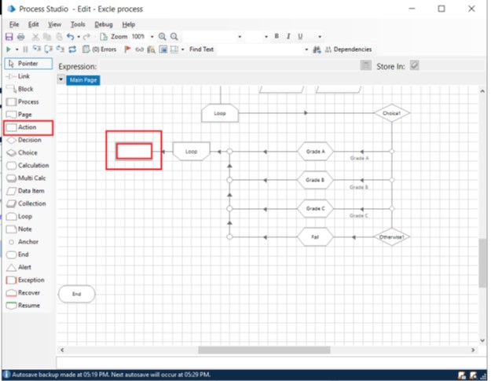
6.Create Action Stage as “Close Student excel file (Business Object = MS Excel VBO; Action = Close WorkBook). a. Click on the Inputs tab 1.Drag “handle” data item into handle Value column. 2.Drag “Workbook Name” data item into the Workbook Name Value column. 3.Save Data as “False”.

Slide 28
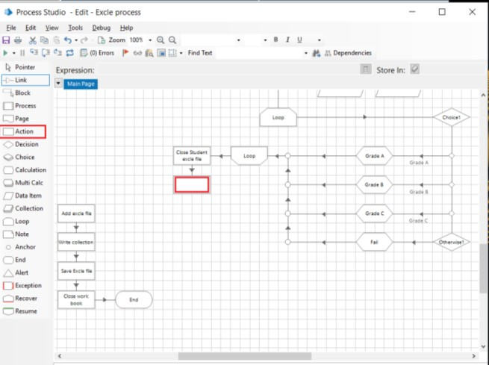
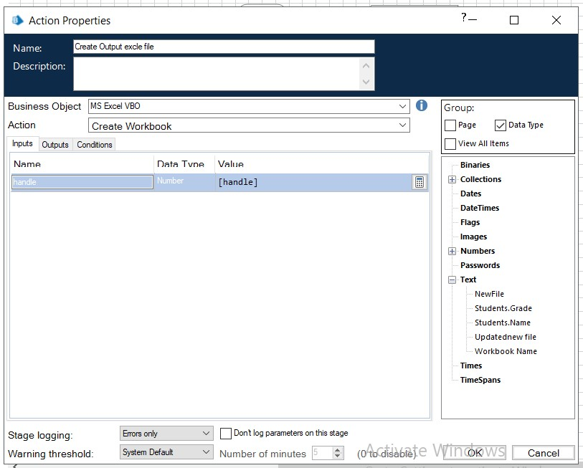
7.Create Action as “Create Output excel file” (Business Object = MS Excel VBO; Action = Create WorkBook).
a. Click on the Inputs tab.
i. Drag “handle” data item into handle Value column.

Slide 29
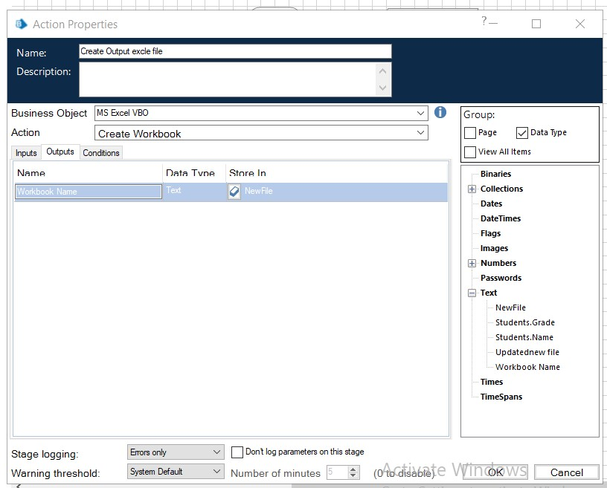
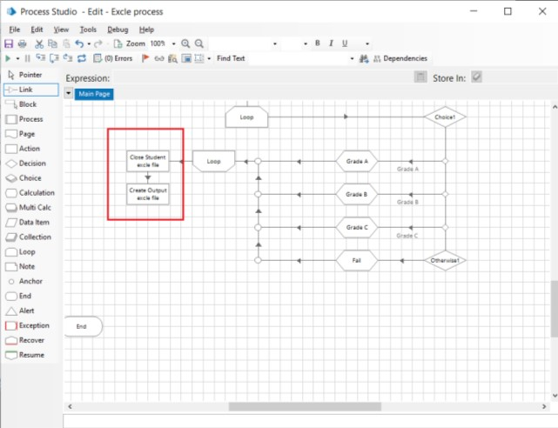
7b. Click on the Outputs tab
i. Create Data Item, type = Text, name =”NewFile''. ii. Drag it into the Workbook Name Store In column. Click on ok

Slide 30
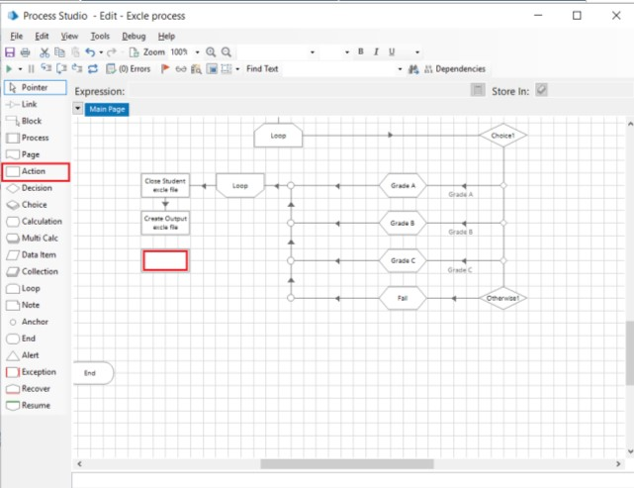
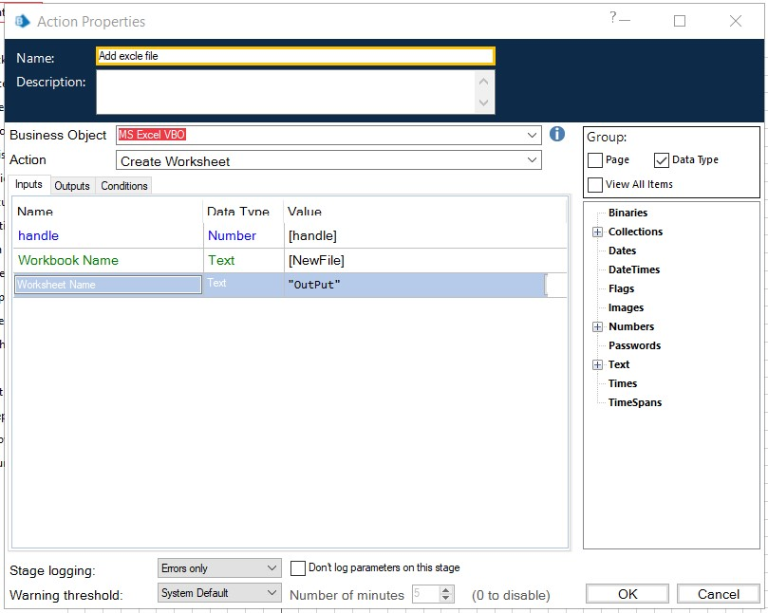
8.Create Action as “Add Excel file” (Business Object = MS Excel VBO; Action = Create Worksheet).
a. Click on the Inputs tab
Drag “handle” data item into handle Value column. ii. Drage “NewFile” data item into the Workbook Name Value column.
iii. Write Worksheet Name name as “OutPut”.

Slide 31
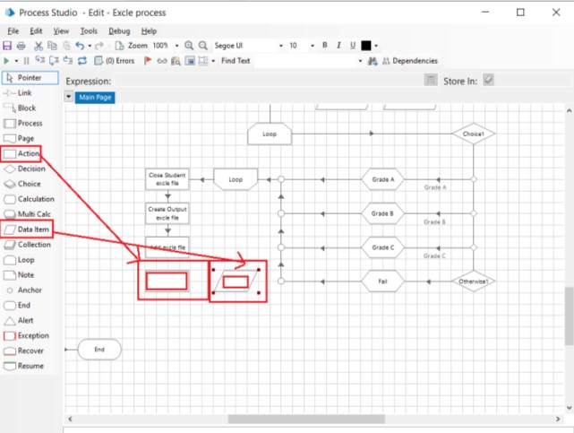
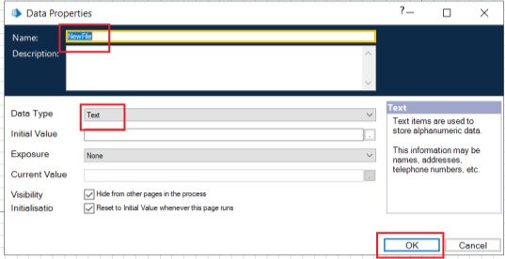
9.Create Action Stage as “Write collection” (Business Object = MS Excel VBO; Action = Write Collection).
Create Data Item as “NewFile”, with type = Text.

Slide 32
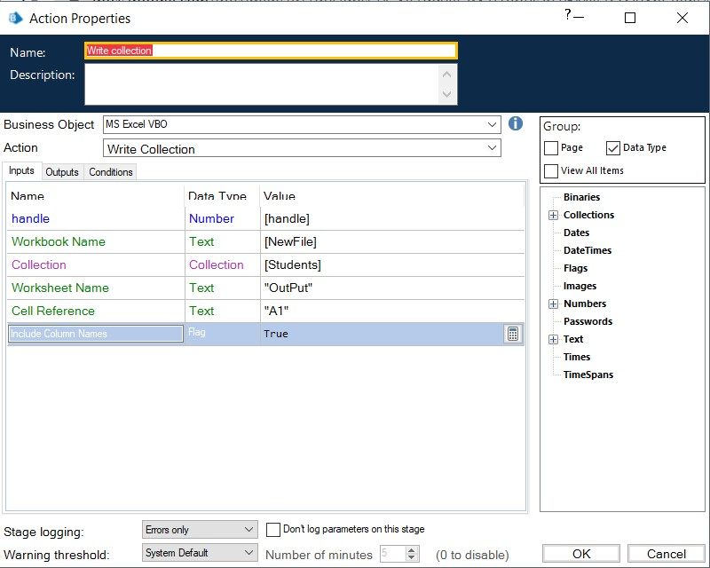
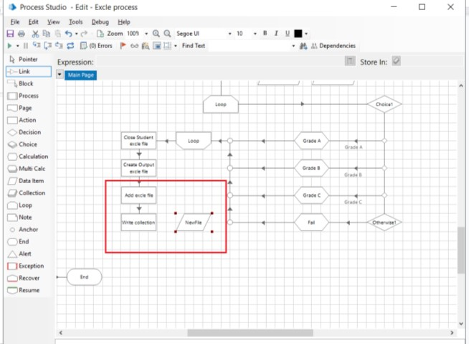
9(b)Click on the Inputs tab
Drag “handle” data item into handle Value column.
Drage “NewFile” data item into the Workbook Name Value column.
iii. Drage “Student” Collection into the Collection Value column
iv. Write Worksheet Name name as “OutPut”.
v. Write Cell Reference as “A1”.
vi.Set Include Column Names as True.

Slide 33
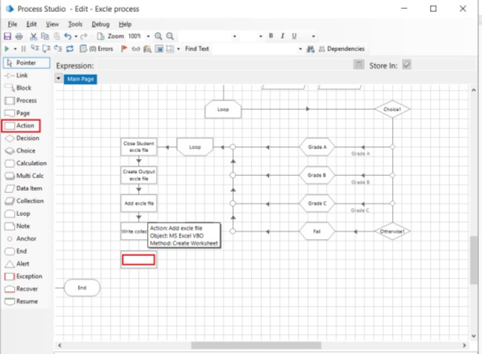

10.Create Action Stage as “Save Excel file” (Business Object = MS Excel VBO; Action = Save Workbook As).
a. Click on the Inputs tab.
i.Drag “handle” data item into handle Value column.
. ii. Drage “NewFile” data item into the Workbook Name Value column.
iii.Write Filename as the path where files want to store

Slide 34
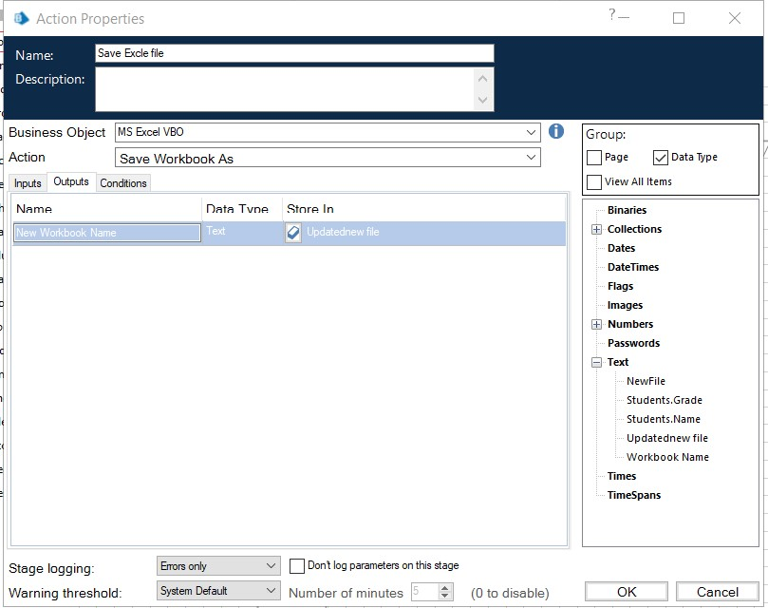
10b. Click on the Output tab
Create Data Item, type = Text, name =”Updated New file”.
ii.Drag it into the New Workbook Name Store In column.
iii. Click on ok.

Slide 35
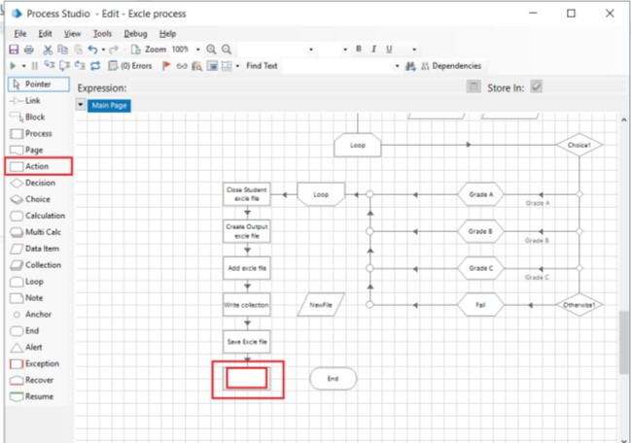
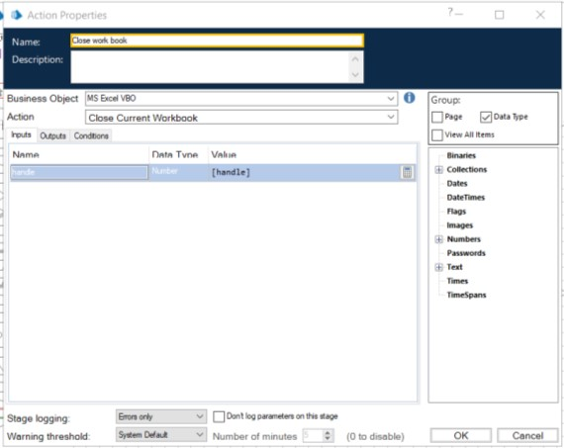
11.Create Action Stage as “Close workbook” (Business Object = MS Excel VBO; Action = Close Current WorkBook).
Click on the Inputs tab
Drag “handle” data item into handle Value column

Slide 36
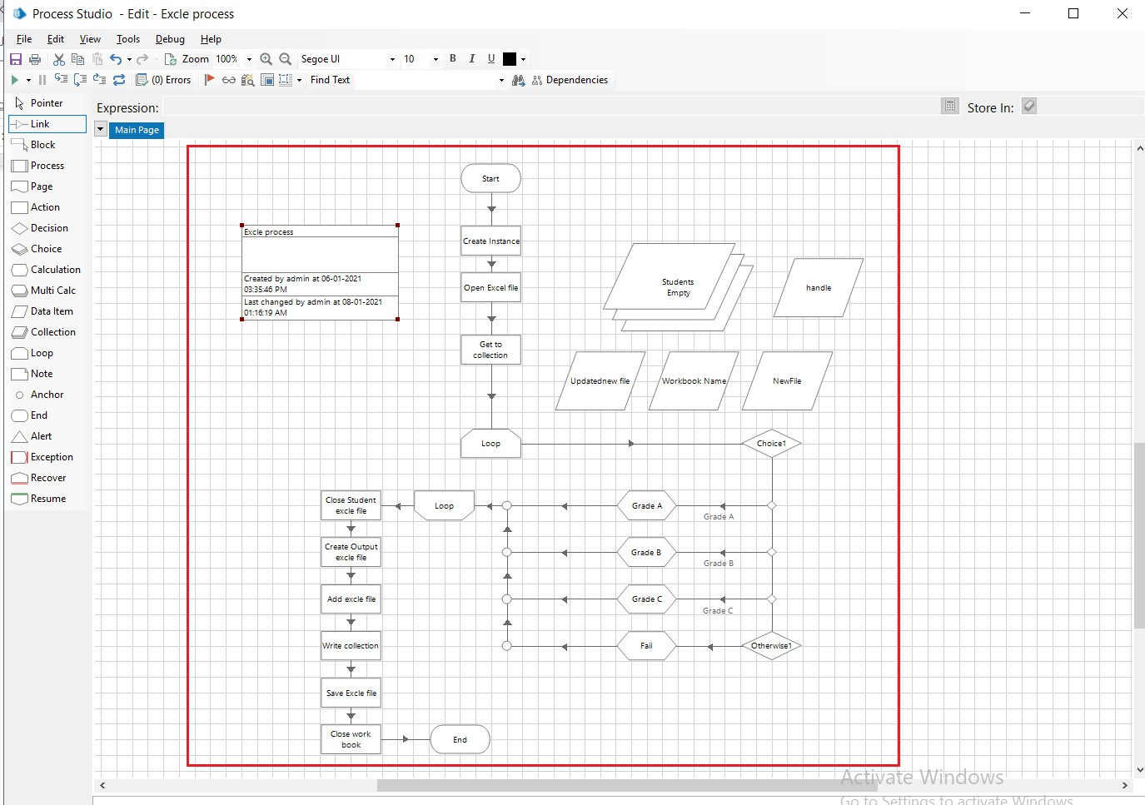
c.connections Do as follows

Slide 37
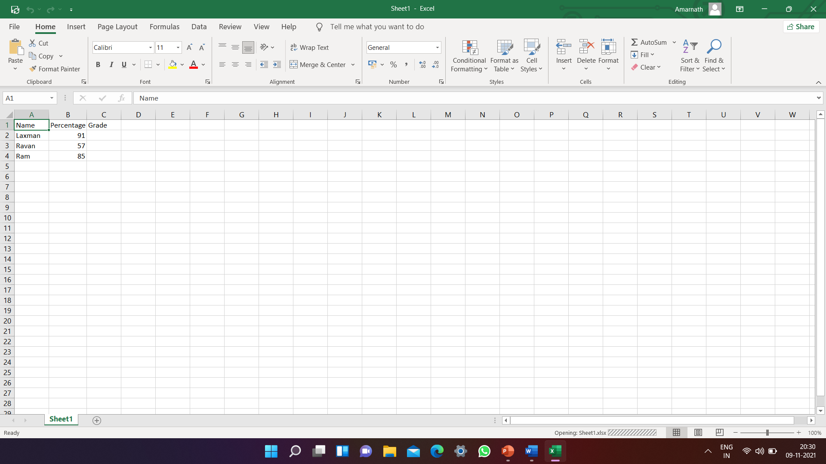
d.Input Excel file data.

Slide 38
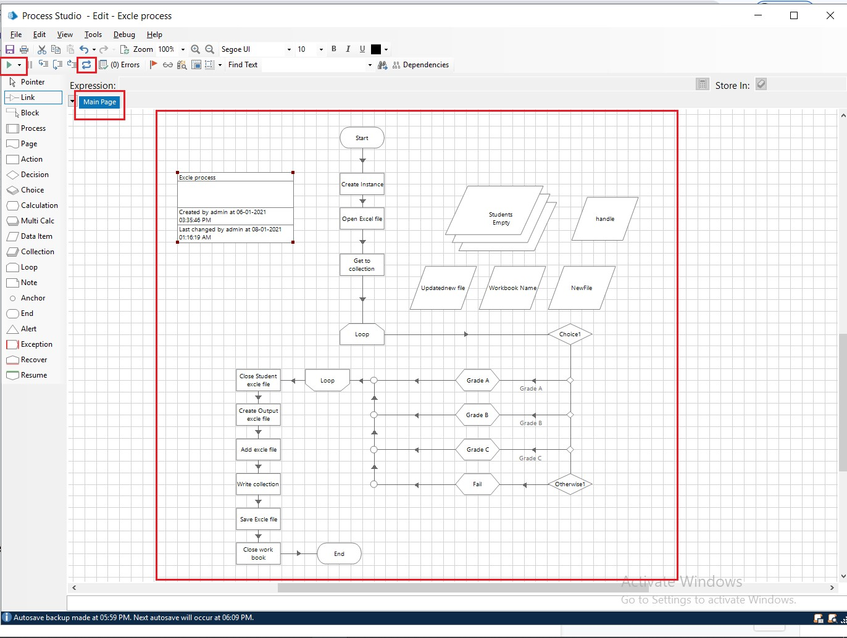
Activity 3: Testing the Process Object from Object Studio
Click on the Main Page, click on the Green play button to run the ‘Excel Process’ Process object. It shows COMPLETED when there is no error or no failure in the object.
Click on the Main Page, click on the Reset button to reset the cache for rerun the process object as fresh.

Slide 39
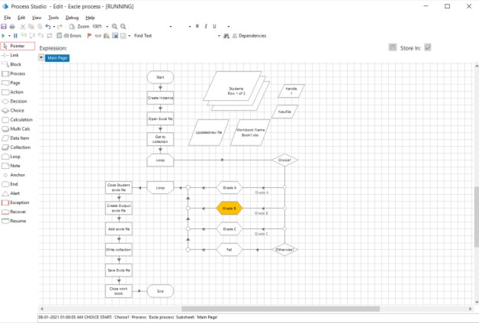
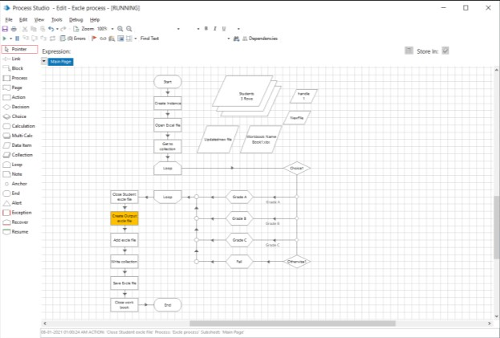

Slide 40
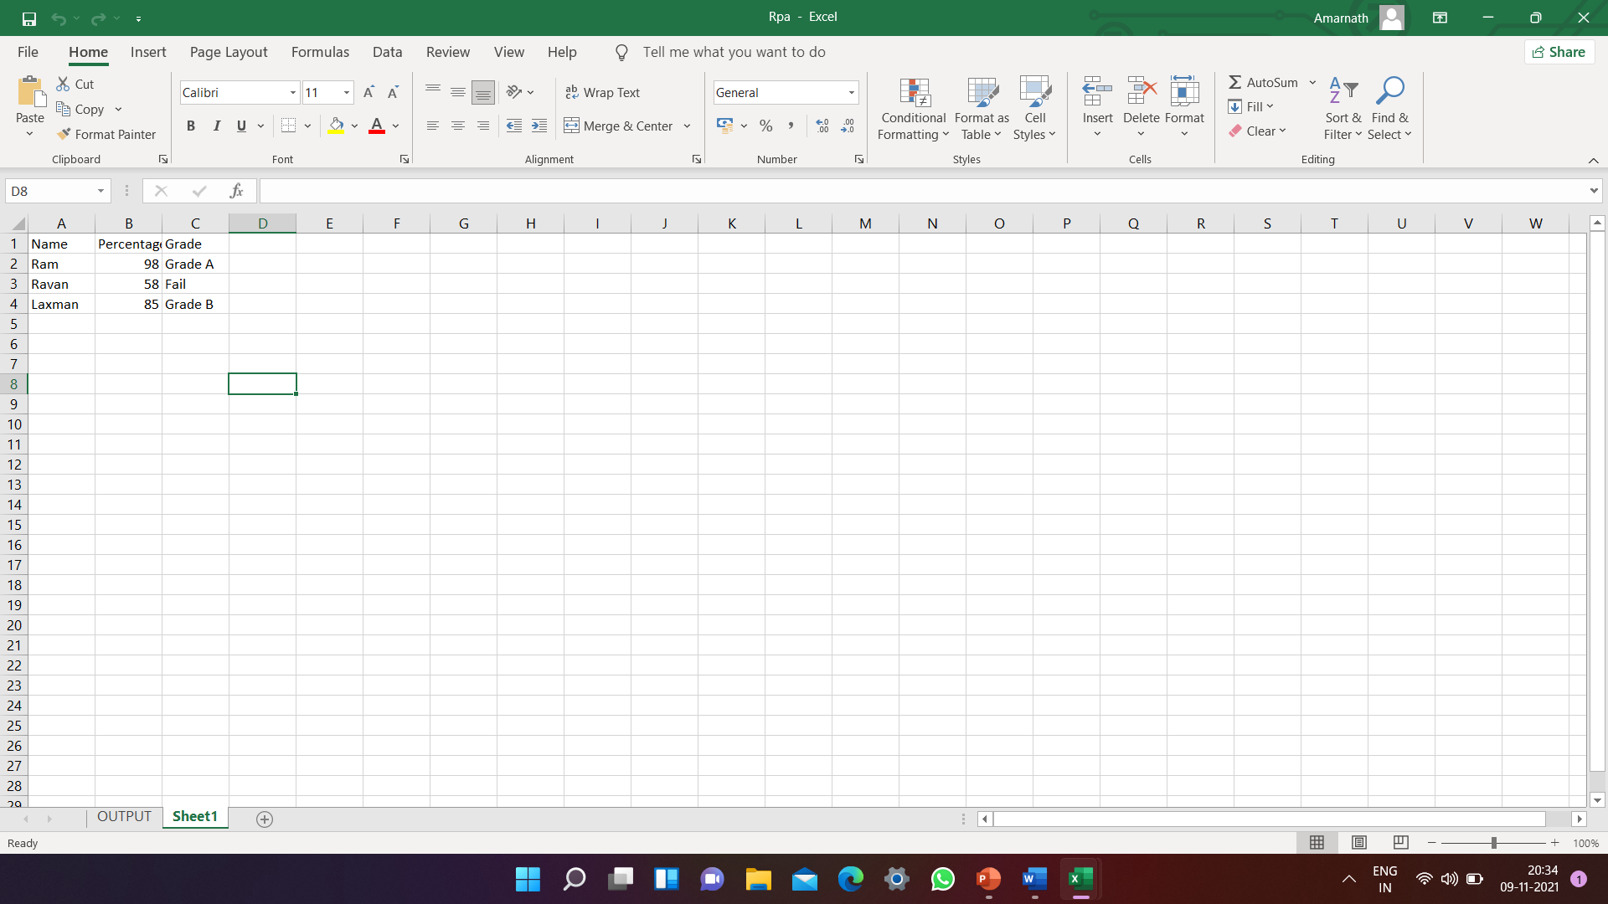
OutPut Excel file.

Slide 41
CONCLUSION
Thus, due to the various benefits of RPA, its utilization is gradually increasing in the market worldwide. Most of the organization are already implementing the RPA technology, as it optimizes the cost and fress the others resources. It is a cost-effective technique and also has nonfinancial benefits such as it consists of more accurate and consistent processes, which are less prone to errors. Nowadays, most of the organizations are using RPA for testing the particular application and eliminating the old testing tools due to its limitations.

Slide 42
FUTURE ENHANCEMENTS
The technology is advancing rapidly in almost all the fields, not in a minute but in every second. With this quick development in technology, tremendous growth has been observed in the global automation industry. The usage of automation techniques is in continuous growth and it is anticipated for the predictable future. The robotic process automation is one of the revolutions in the automation industry, and its expected to increase higher potential terms of utilization and staff implementation in the upcoming year.

Slide 43
BIBLIOGRAPHY AND REFERENCES
Websites:
https://ieeexplore.ieee.org/Xplore
www.uipath.com
Research paper:
Robotic Process Automation: A Scientific and Industrial Systematic
Mapping Study
By J. G. Enríquez;A. Jiménez-Ramírez;F. J. Domínguez-Mayo;J. A. García-García

